Slide 1


Microprocessor Architecture and Internet of Things
Course Code: CET3014B Credits: 3 TH+2 Lab=5

Slide 2
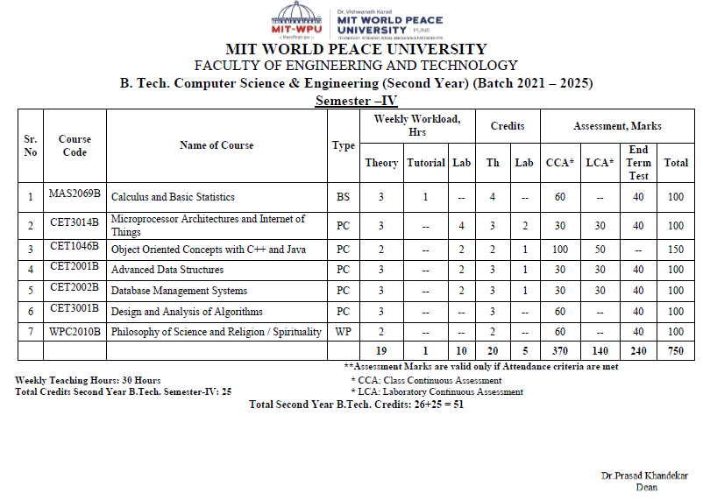
Course Structure - SY

Slide 3
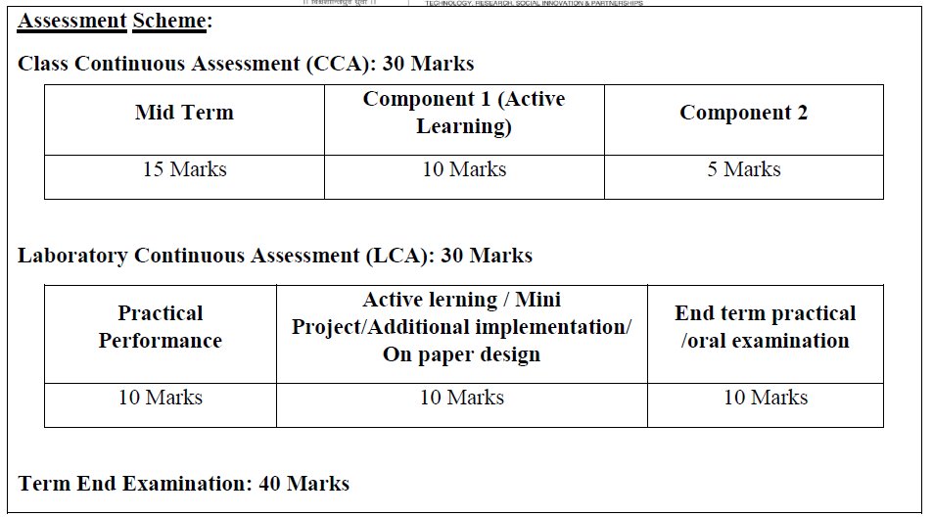
CCA LCA

Slide 4
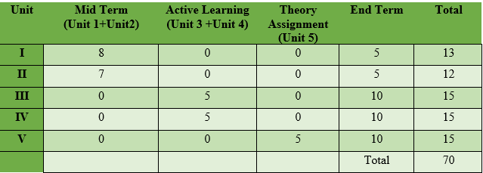
Unit wise distribution of CCA-70 Marks
LCA-30 Marks

Slide 5
Syllabus
Module I: Overview of Embedded System and IoT
Module II:Pentium Architecture:
Embedded Systems: Architecture & Characteristics of ES, Types of Embedded systems, Examples of Embedded Systems. Introduction of IoT: Definition and characteristics of IoT, Technical Building blocks of IoT, Device, Communication Technologies, Data, Physical design of IoT, IoT enabling technologies, IoT Issues and Challenges- Planning, Costs and Quality, Security and Privacy, Risks. Example: Smart Home /Smart Agricultural.
Pentium features, Pentium superscalar architecture - Pipelining, Branch prediction, and Instruction and Data caches. The Floating-Point Unit: features, pipeline stages & data types. Pentium programmer's model, register set, System registers, addressing modes and Instruction set.

Slide 6
Syllabus
Module III:Pentium operating modes:
Pentium Modes of Operation, Pentium Real address mode: Memory organization, Memory segments, Segment registers, logical to physical address generation.
Protected mode: Segmentation unit, support registers, related instructions, segment Memory descriptors, logical to linear address translations.
Module IV:Paging and Protection:
Paging Unit: support registers, related data structures, linear to physical address translation, TLB Protection by segmentation, privilege-levels, rules of inter-privilege level transfer for data and code segments, page level protection.

Slide 7
Syllabus
Unit 5: Pentium Task Management and Interrupt handling:
Task Management, support registers, related data structures, Task switching. Interrupt and Exception Overview, Sources of Interrupts & exceptions, Exception and Interrupt Vectors, Interrupt Descriptor Table (IDT), IDT Descriptors, Exception- or Interrupt-Handler Procedures

Slide 8
Learning Resources:
Text Books:
1. The Internet of Things by Hakima Chaouchi Publishers: ISTE and Willey
2. James Antonakos, “The Pentium Microprocessor”, 2004, Pearson Education ISBN – 81-7808-545-3.
Reference Books:
1. Beginning Arduino by Micheal McRoberts Publishers: Technology in Action
2. IoT Fundamental by Devid Hanes Publishers: CISCO
3. Raspberry Pi Cookbook for Python Programmers by Tim Cox Publishers: PACKT
4. The Official Raspberry Pi Project Book
5. Beginning Sensor Networks with Arduino and Raspberry Pi by Charles Bell Publishers: Technology in Action
6. Intel architecture software developer's manual volume 3.
7. Intel architecture software developer's manual volume 1.
8. Intel 64 and IA-32 Architecture’s software developer's manual

Slide 9
Course Objectives:
By participating in and understanding all facets of this Course a student will be able:
1. Knowledge:
i. To understand the components and techniques used in IoT development environment
ii. To apply the knowledge of fundamentals in IoT for various applications.
iii. To acquire the knowledge of the Pentium processor architectural features, programmer’s model, system registers.
2. Skill:
i. To learn Pentium addressing modes and instruction set for the development of x86/64-bit assembly language programs.
3. Attitude:
i. To describe the role of Memory Management Unit and Privilege levels in protected mode of Pentium processor.
ii. To learn the role of CPU in handling multitasking and processing of interrupts and exceptions in Pentium environment.

Slide 10
Course Outcomes:
By the end of the course, students will be able to
1. Describe the details of IoT based systems.
2. Demonstrate the use of common IoT platforms and installations.
3. Discuss Pentium architecture and programmer’s model.
4. Apply the Assembly Language Programming skills of Pentium processor.
5. Interpret the demand paging and protection mechanism supported in Pentium Architecture.
6. Demonstrate the concept of Task management and Interrupt handling within the Pentium processor.

Slide 11

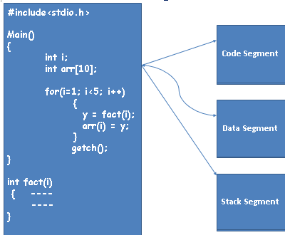
Segment
Each user program includes –
Code (logic)
Data (variables )
Most programs implement the logic using functions.
The function CALLS and RETURNS are executed with the help of additional memory called STACK.
Segment:
Area of memory
Used for different purposes
(e.g. Code / Data /Stack)

Slide 12

Segments in Pentium Protected Mode
Segments are not ----
All the same size
Necessarily paragraph aligned
Limited to 64 KB

Slide 13
8086 Processor
No Memory Management Unit- No protection
Protection –Restricted Access to Data , Code & Stack
Application program size limited to available memory (RAM /1MB)
Single tasking environment
Segment size maximum 64KB

Slide 14

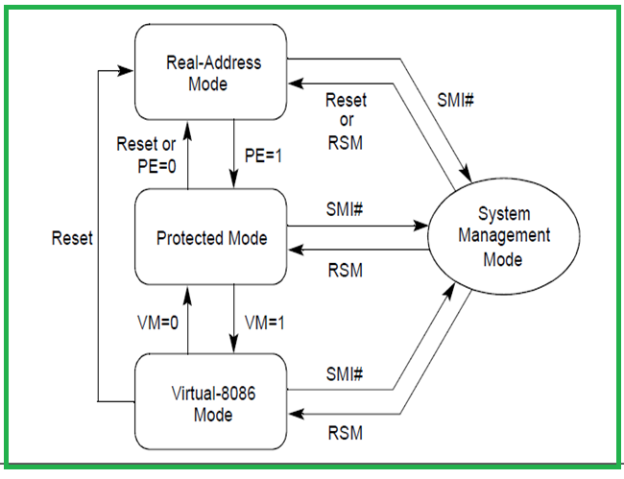
Operating Modes of Pentium and Mode Transition Diagram
System Management Interrupt
Real Mode
Protected Mode
Virtual 8086 Mode
System Management Mode

Slide 15
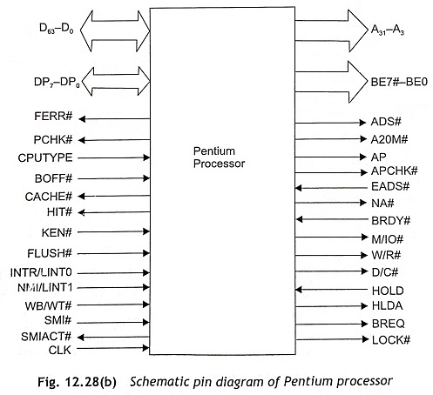
Details of Operating Modes of Pentium :Extra Information
https://www.eeeguide.com/pin-diagram-of-pentium-processor/

Slide 16
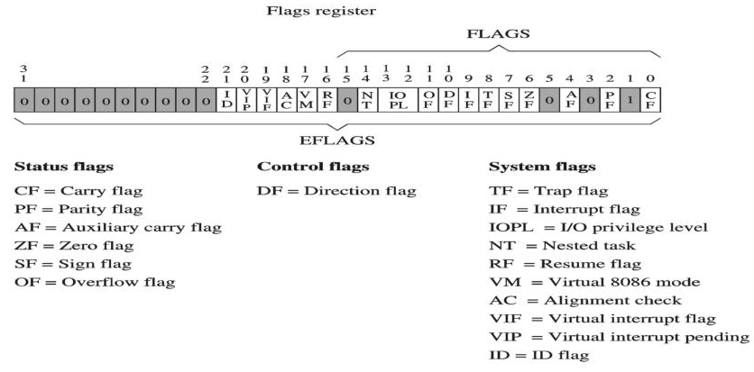
Flag Register

Slide 17
Details of Operating Modes of Pentium
Pentium supports 3 Operating and One Quasi-Operating mode
Protected Mode
Real address Mode
Virtual 8086 mode
System Management Mode

Slide 18
Pentium Modes of Operation
Real Address Mode:
Provides the programming environment of the Intel 8086 processor with few extensions such as ability to switch to PM.
Protected Mode:
All instructions and Architectural Features are available .
Virtual 86 Mode:
This mode allows the processor to execute 8086 software in a Protected, Multitasking environment.

Slide 19
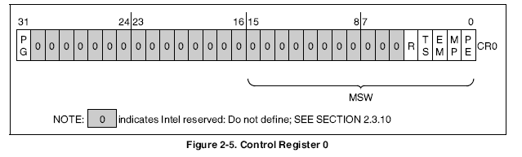
Important Bits

Slide 20
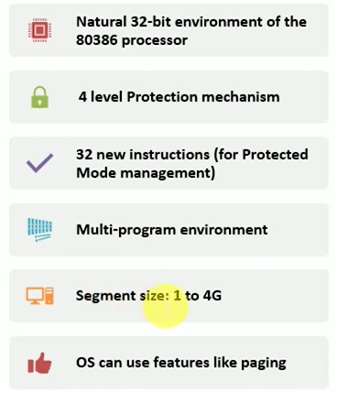
Details of Operating Modes of Pentium: Protected Mode
Protected Mode
It’s a Native operating mode
Provides highest performance and capability by allowing all the features and instruction having permission to execute.
Most recommended mode for new application and OS.

Slide 21
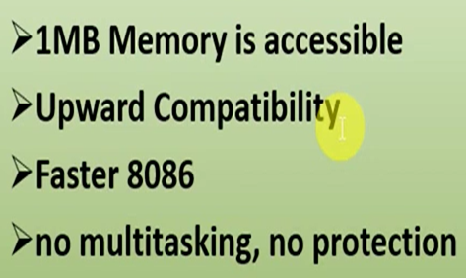
Details of Operating Modes of Pentium: Real Address Mode
2. Real Address Mode:
Provides the programming environment of 8086 with few extensions.
Provides facility to switch to Protected or System Management Mode.

Slide 22
Details of Operating Modes of Pentium :System Management Mode
System Management Mode
It’s a Standard architectural feature in all Intel Processors.
Provides mechanism of Power Management.
SMM is entered through activation of an external system interrupt pin (SMI#) which generates a system management interrupt (SMI).
In SMM, the processor switches to a separate address space while saving the context of the currently running program or task.
SMM-specific code may then be executed transparently.
Upon returning from SMM, the processor is placed back into its state prior to the SMI
This mode is designed for fast state snapshot and resumption (Beginning again). https://patents.google.com/patent/US9747357B2/en

Slide 23
Switching across the Modes
Power On- Reset leads to start in Real Address Mode.
PE- Protection Enable bit of CR0 used to enter Protected Mode from Real Mode.
VM-Virtual Mode Flag bit decides execution in Protected or Virtual mode.
Enters SMM on receiving External System Interrupt signal on SMI irrespective of currently it is in Real , Protected or Virtual mode.
Instruction RSM (Resume System Mode) is used to return from SMM to previous mode from where processor had switched.

Slide 24
Protected Mode Features
Multitasking
Protection
Virtual Memory- Demand Paging

Slide 25

Protected Mode Memory Management
Overview:--------
Managing Memory in different parts instead of continuous allocation of locations.
Divided into two parts : Segmentation and Paging.

Slide 26
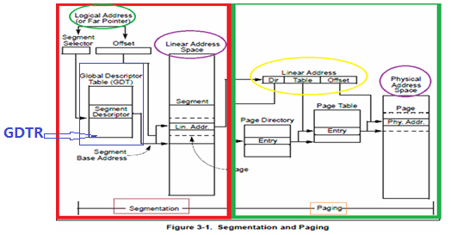
Protected Mode: Memory Management Overview

Slide 27
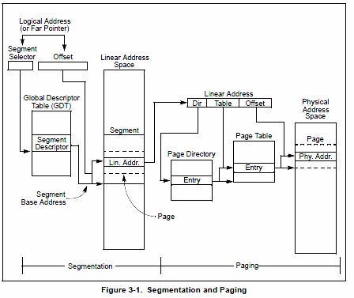
Protected Mode Memory Management Overview
Segmentation: Mechanism to isolate individual code, data, and stack modules so that multiple programs/tasks can run on the same processor without interfering with one another.
When operating in protected mode, some form of segmentation must be used.
There is no mode bit to disable segmentation.

Slide 28
Protected Mode Memory Management Overview
Paging: Mechanism to implement a conventional demand-paged, virtual-memory system where sections of a program’s execution environment are mapped into physical memory as needed.
Paging can also provide isolation between multiple tasks.
The use of paging, however, is optional.

Slide 29
Protected Mode Memory Management Overview
If paging is not used, the linear address space of the processor is mapped directly into the physical
address space of processor.
The physical address space is defined as the range of addresses that the processor can generate on its address bus.

Slide 30
Segmentation Unit
Divides processor’s addressable memory space (Linear Address Space) into smaller protected address space called segments.
Defines various types of segments with different attributes and provides segment level protection.
Isolation of code , data and stack modules.
Cannot be Disabled. There is No Bit available to Disable segmentation
It converts Logical Address to Linear Address.
https://www.youtube.com/watch?v=p9yZNLeOj4s
https://www.youtube.com/watch?v=Gjfiuj3lm2o

Slide 31
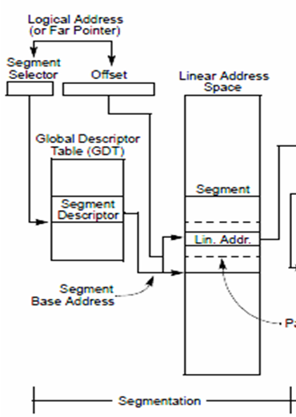
Segment in Pentium Protected Mode
Area of memory:
Can be of variable sizes and maximum size can be of 4GB (2³² Bytes)
Used for different purposes (e.g. Code/Data/Stack)
Have certain attributes associated with them
Defined by System Programmer
All the segments are Fitted in Linear address Space.
Base address (32bit) + Offset (32bit) = Linear Address

Slide 32

Protected Mode Memory Management Segmentation Unit
Segments are used to hold :
Code
Data
Stack
TSS
LDT

Slide 33
Segment Descriptor
Every memory segment is described by a special structure called Segment Descriptor
It describes-
Segment Base Address: 32 Bit (Location of first byte of the segment in the linear address space)
Size/Length of Segment: 20 Bit (largest valid offset of the segment described)
Segment type / Use: 4 Bit
Privilege Level: 2 Bit
Access Right/Miscellaneous: 6 Bits (G, D/B (Default (Data and Code)/ Big (Stack) ), AVL-Available for use by system software, P, S- Descriptor type (System Descriptor (0-TSS, LDT) or Non Segment Descriptor (1-Data,Code and Stack)))
(32+20+4+2+6=64 bits=8 bytes)
Base Addr. 31:24 | G | D/B | O | AVL | Seg. Limit 19:16 | P | DPL (2 bit) | S | Type (4 bit) | Base Addr 23:16
Base Address 15:00 | Segment Limit 15:00

Slide 34
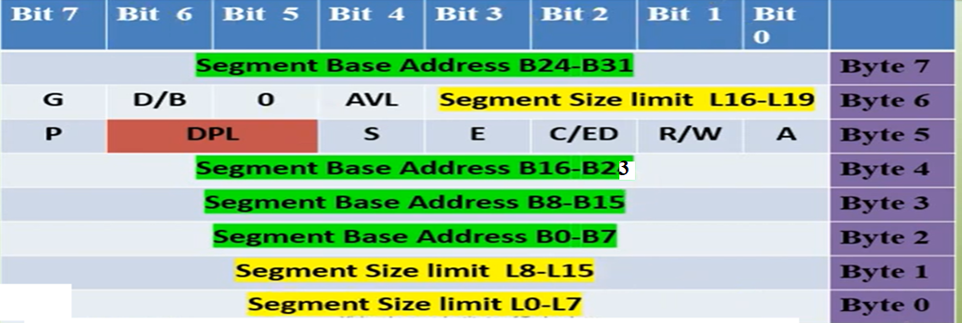
Segment Descriptor
Base Addr. 31:24 | G | D/B | O | AVL | Seg. Limit 19:16 | P | DPL (2 bit) | S | Type (4 bit) | Base Addr 23:16
Base Address 15:00 | Segment Limit 15:00

Slide 35
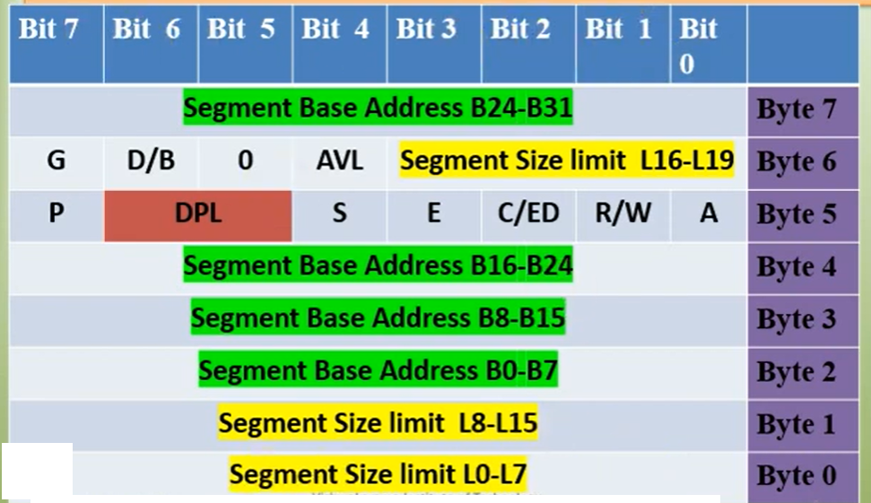
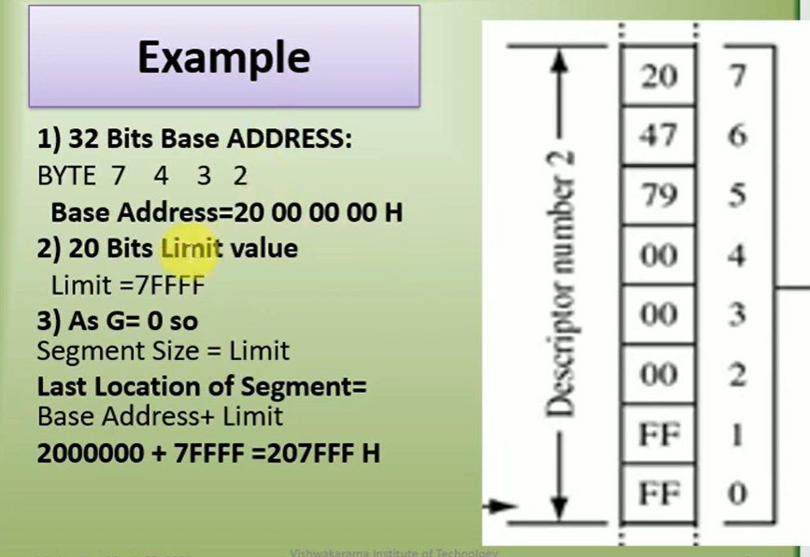
Segment Descriptor
20 47 79 00 00 00 FF FF
Base Addr. 31:24 | G | D/B | O | AVL | Seg. Limit 19:16 | P | DPL (2 bit) | S | Type (4 bit) | Base Addr 23:16
Base Address 15:00 | Segment Limit 15:00

Slide 36
Segment Descriptor Cont-
Base Address - Segment Base Address (32 bit)
LIMIT------------ Segment Limit (20 bit)
Access Rights Byte –
P ------Segment Present
S ------ Descriptor type (System or Non System)
TYPE --Segment Type (4 Bits)
DPL --- Descriptor’s Privilege Level
AVL – Available for use by system software
D/B---Default (Data and Code)/ Big (Stack) operation size
G- Granularity

Slide 37
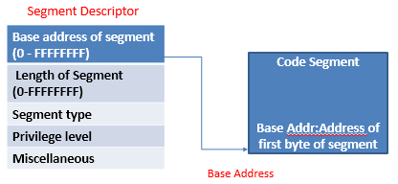
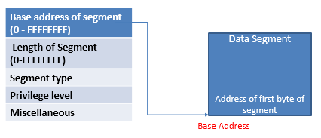
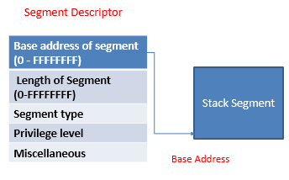
Segment and Segment Descriptor
Every memory segment is described by a special structure called segment descriptor
Size of segment descriptor is of 8 Bytes
It describes-
segment Base Address (added with offset value to generate linear address) & Size of Segment (largest valid offset of the segment described)
Segment type/Use
Access Right
Privilege Level

Slide 38
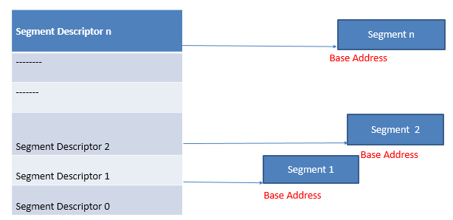
Segment Descriptor Table
A Segment Descriptor Table is an array of segment descriptors
Notes:
3.5.1 from Pentium manual Volume-3

Slide 39
Segment Descriptor Table
Segment descriptors are grouped and placed together in contiguous memory locations.
This group of arrangement is known as a Descriptor Table.
A segment descriptor table is an Array of segment descriptors.
Order of descriptors is not important.
A descriptor table is variable in length and can contain up to 8192- 8 Byte Descriptors. ( 2¹³ )
Table can have one descriptor in it or as many as 8192 descriptors

Slide 40
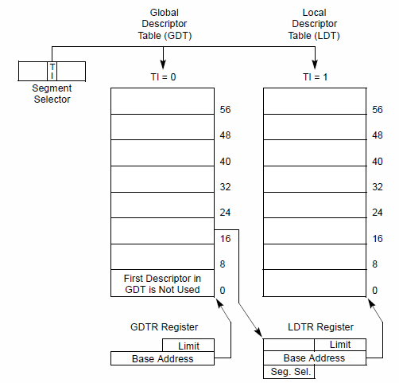
Segment Descriptor Table
Descriptor table is variable in length and can contain up to 8192= (2¹³) - 8byte descriptors.
Types are:
GDT – Global Descriptor Table
LDT – Local Descriptor Table
IDT – Interrupt Descriptor Table
TI-Table Indicator

Slide 41
Segment Descriptor Table
Each system must have one GDT defined , which may be used for all program and tasks.
GDT is not a segment itself but, data structure in linear address space.

Slide 42
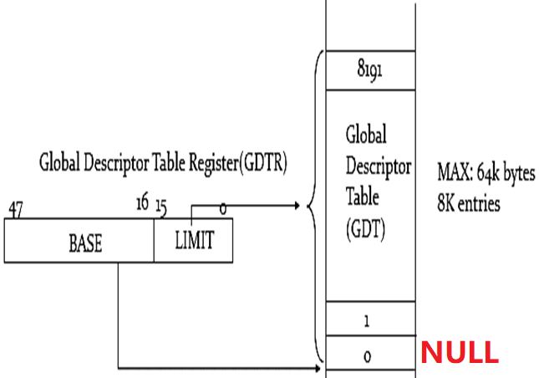
Segment Descriptor Table (GDT)
Maintains segment descriptors - Max. 8192 descriptors
Max size of GDT – 64KB= (8192 x 8 bytes).
First descriptor – NULL
The first descriptor in the GDT is not used by the processor.
GDT Register (GDTR) points to base of GDT.
The base address and limit of GDT must be loaded in GDTR register.
32 Bit
16 Bit
32+16=48 Bit

Slide 43
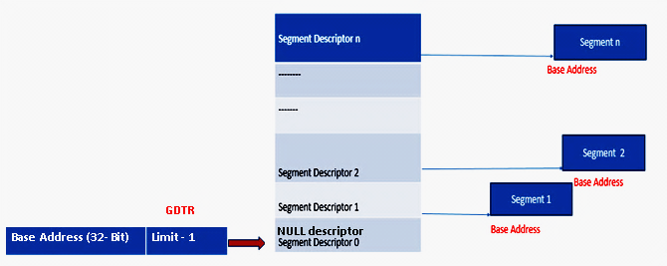
Global Descriptor Table Register (GDTR)
Global Descriptor Table (GDT)
GDTR Points to base address of GDT
The base addresses of the GDT should be aligned on an eight-byte boundary.
The limit value for the GDT is expressed in bytes.
The limit value is added to the base address to get the address of the last valid byte.
A limit value of 0 results in exactly one valid byte.
As segment descriptors are always 8 bytes long, the GDT limit should always be one less than an integral multiple of eight (i.e., 8N – 1).

Slide 44
Global Descriptor Table Register (GDTR)
Linear Base Address (32 bit) | Table Limit (16 bit)
Points to base of GDT
Holds the base address of 32 bit along with 16 bit table limit for the GDT.
The base address specifies the linear address of byte 0 of the GDT.
The table limit specifies the number of bytes in the table (Actual number of bytes-1 For e.g. If Limit =7, Number of bytes present in table= 8 bytes).
Limit= Length of the Table-1((Number of descriptors x 8)-1 in terms of bytes / 4KBytes).
LGDT - SGDT instructions load and store the GDTR Register.
During power ON default value is set to 0 with limit 0FFFFH (64KB).
A new base address must be loaded into the GDTR as part of the processor initialization process for protected-mode operation.

Slide 45
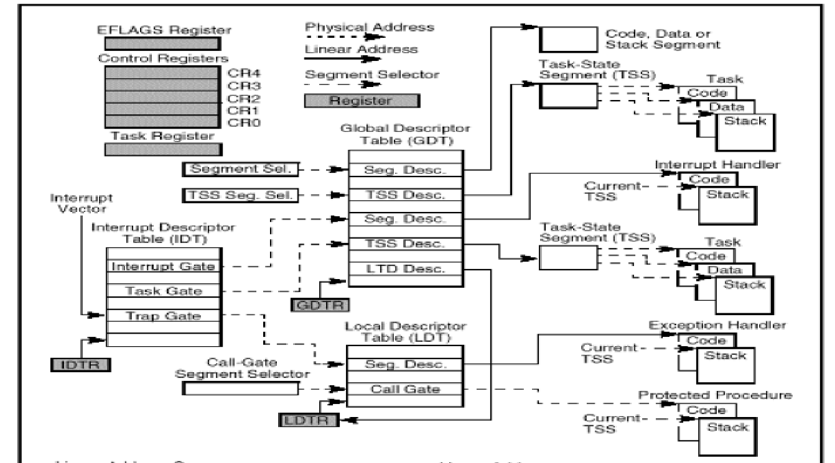
Segment Descriptor Table

Slide 46
Segment Descriptor Table- LDT ---Local Descriptor Table
Can be optionally created to maintain descriptors of a unique program/task.
Each task can have access to its own private descriptor table in addition to the GDT.
One or more LDTs can be defined-
For example, a LDT can be defined for each separate task being run, or some or all tasks can share the same LDT.
Located in a system segment of the LDT type.
GDT contains a segment descriptor for the LDT segment, can be located anywhere in the GDT.
The LDT may contain only code, data, stack, task gate, and call gate descriptors.
LDTs provide a mechanism for isolating a given task's code and data segments from the rest of the operating system.

Slide 47
Segment Descriptor Table
IDT (Interrupt Descriptor Table):
The Interrupt descriptor table (IDT) holds segment descriptors that define interrupt or exception handling routines.
IDT associates each exception or interrupt vector with a descriptor called Gate descriptor for the procedure or task (ISR-interrupt service routines) used to service the associated exception or interrupt.
It is defined by the interrupt descriptor table register (IDTR)
It is direct replacement for Interrupt Vector Table (IVT) in 8086
One GDT & IDT must be defined to operate in Protected Mode
Notes:
3.5.1 from Pentium manual Volume-3
3.5.1 from Pentium manual Volume-3

Slide 48
Segment Descriptor Table
IDT (Interrupt Descriptor Table):
Like the GDT and LDTs, the IDT is an array of 8-byte descriptors.
Unlike the GDT, the first entry of the IDT may contain a descriptor.
To form an index into the IDT, the processor scales/multiplies the exception or interrupt vector by eight (the number of bytes in a gate descriptor).
As there are only 256 interrupt or exception vectors, the IDT need not contain more than 256 descriptors.
It can contain fewer than 256 descriptors, because descriptors are
required only for the interrupt and exception vectors that may occur.
Notes:
5.8from Pentium manual Volume-3
3.5.1 from Pentium manual Volume-3

Slide 49
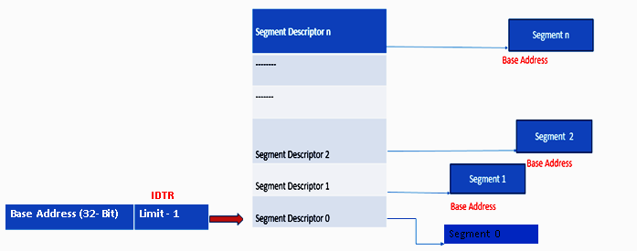
Interrupt Descriptor Table Register (IDTR)
Interrupt Descriptor Table (IDT)
IDTR Points to base address of IDT

Slide 50
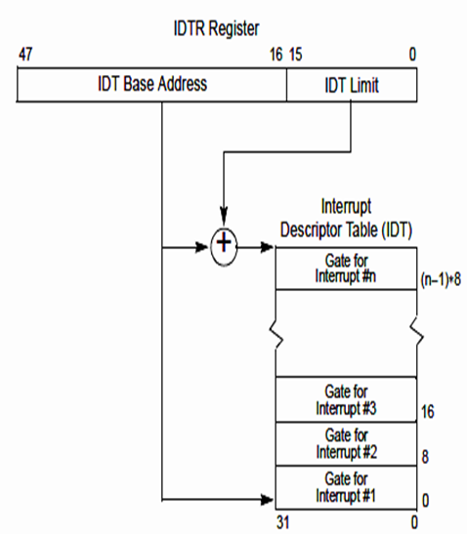
Interrupt Descriptor Table Register (IDTR)
IDTR: Points to base of IDT.
Holds base address and limit for IDT.
The base address specifies the linear address of byte 0 of the IDT.
The table limit specifies the number of bytes in the table.
LIDT and SIDT instructions are used to load and store IDTR register.
During power ON default value is set to 0 with limit 0FFFFH (64KB=2^16) which can be changed as part of the processor initialization process.

Slide 51
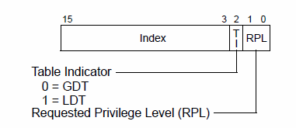
Segment Selector
E.g. If 16 bit selector value= 0011H
Then in binary its value is 0000 0000 0001 0001 It is divided into 3 fields Index, TI and RPL
It represents descriptor with index 2 (starting from 0, 3rd descriptor means Seg Descriptor 2) in GDT with RPL=1
Bit Number | 15 | 14 | 13 | 12 | 11 | 10 | 9 | 8 | 7 | 6 | 5 | 4 | 3 | 2 | 1 | 0
Value in Binary | 0 | 0 | 0 | 0 | 0 | 0 | 0 | 0 | 0 | 0 | 0 | 1 | 0 | 0 | 0 | 1
Value in Hex | 0 | 0 |  |  |  | 0 |  |  |  | 2 |  |  |  | 0 | 1
Field Name | Index = 0002 H |  |  |  |  |  |  |  |  |  |  |  |  | TI=0 GDT | RPL=1

Slide 52
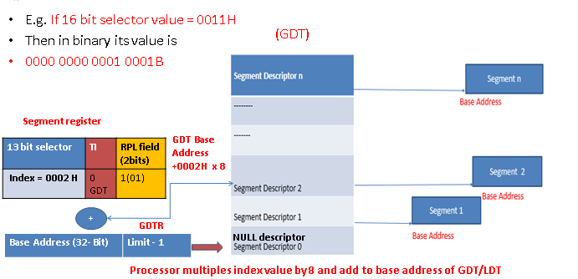
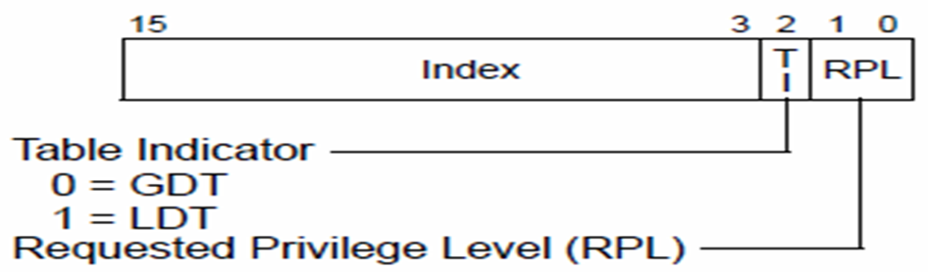
Segment Selector
A 16 bit identifier, it does not point directly to the segment but, point to the segment descriptor (may be present in GDT or LDT) that defines the segment.
Segment registers becomes segment selectors in protected mode.
Notes:
3.4.1 and 3.4.2

Slide 53
Problem
Q. If DS = 0032H then which segment descriptor will be selected?. From GDT or LDT?
What will be the starting address (Offset) of selected segment descriptor in GDT.

Slide 54
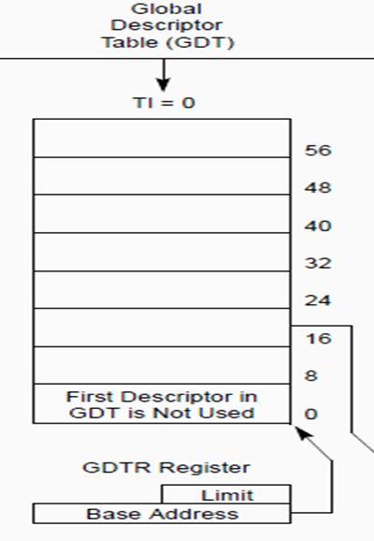
Problem
Q. If DS = 0032H then which segment descriptor will be selected?. From GDT or LDT? What will be the starting address(Offset) of selected segment descriptor in GDT.
Ans. DS = 0032H = 0000 0000 0011 0010 b
RPL = 10 = PL2
TI = 0 => GDT will be selected
Index = 0000 0000 0011 0
= 0 0000 0000 0110 = 0006H
So 6th descriptor from GDT will be selected.
Starting address of the 6th Descriptor = 6 * 8 = 48
Offset of selected segment descriptor in GDT is 48 or 30H

Slide 55
Problem
Q. If LDTR = 0054H then which segment descriptor will be selected?. From GDT or LDT? What will be the starting address(Offset) of selected segment descriptor in GDT.
Ans. LDTR = 0054H = 0000 0000 0101 0100 b
RPL = 00 = PL0
TI = 1=> LDT will be selected
Index = 0000 0000 0101 0
= 0 0000 0000 1010 = 000AH
So 10th descriptor from GDT will be selected.
Starting address of the 10th Descriptor = 10 * 8 = 80
Offset of selected segment descriptor in GDT is 80 or 50H

Slide 56
Segment Selector
Index: Bit 3 to 15, selects one of 8192 descriptor from GDT/LDT. Processor multiples index value by 8 and add to base address of GDT/LDT.
TI: Table Indicator: specifies use of GDT or LDT.
TI = 0 selects GDT & TI = 1 select LDT
RPL (Requested Privilege Level) : having value from 0 to 3, with 0 as highest Privilege

Slide 57
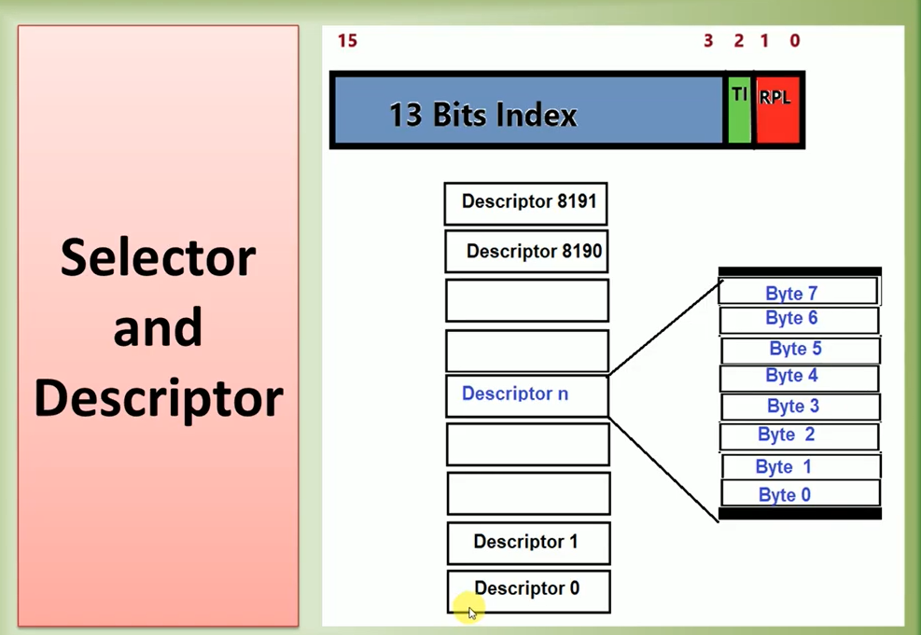

Slide 58
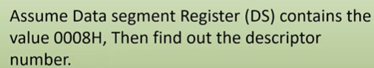
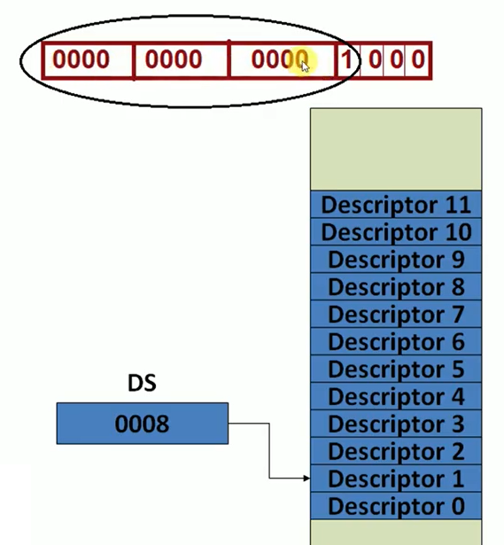
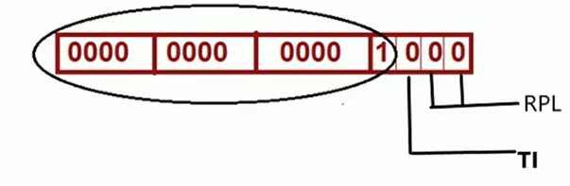
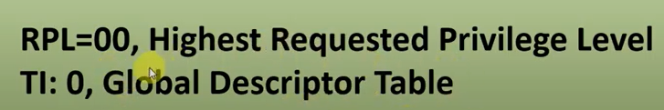
Ex. QUIZ

Slide 59

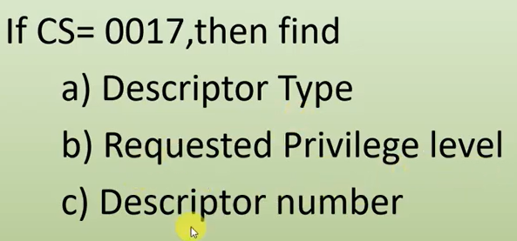
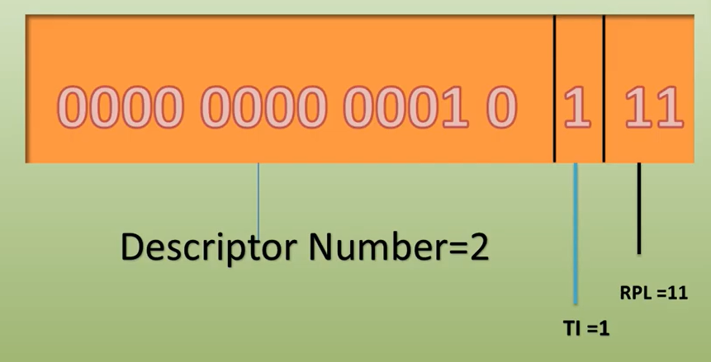

Slide 60
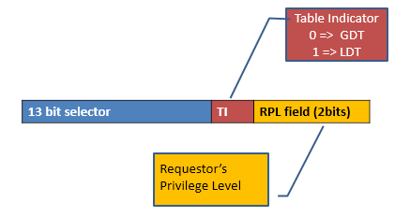
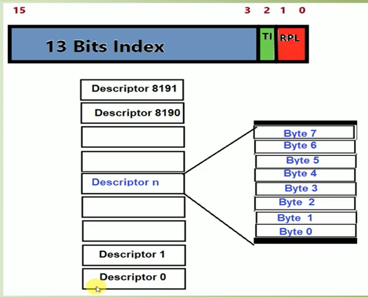
Segment Selector
Segment Registers are selectors
Select a unique descriptor from GDT / LDT
Types – Code, data, stack
CS register selects Code Segment Descriptor
DS register selects Data Segment Descriptor
SS register selects Stack Segment Descriptor

Slide 61
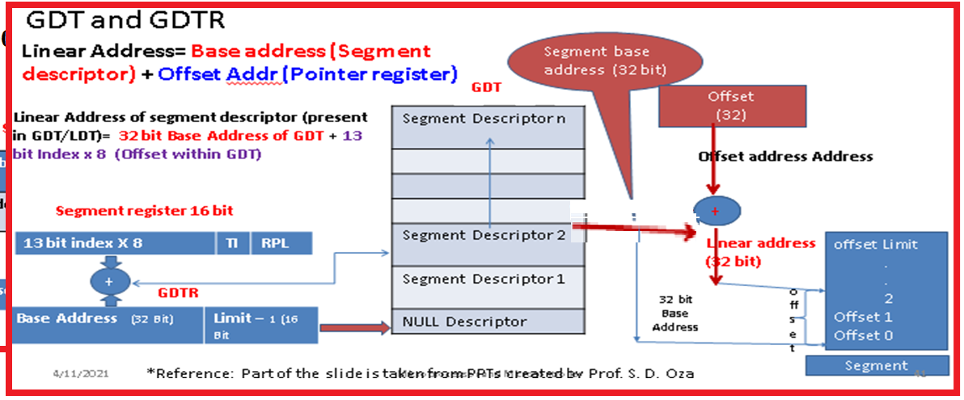
Global Descriptor Table and Segment Selector (Logical to Linear address conversion)
In protected mode to access byte from any segment Linear Address is calculated by adding Base address from respective segment descriptor and offset address.

Slide 62
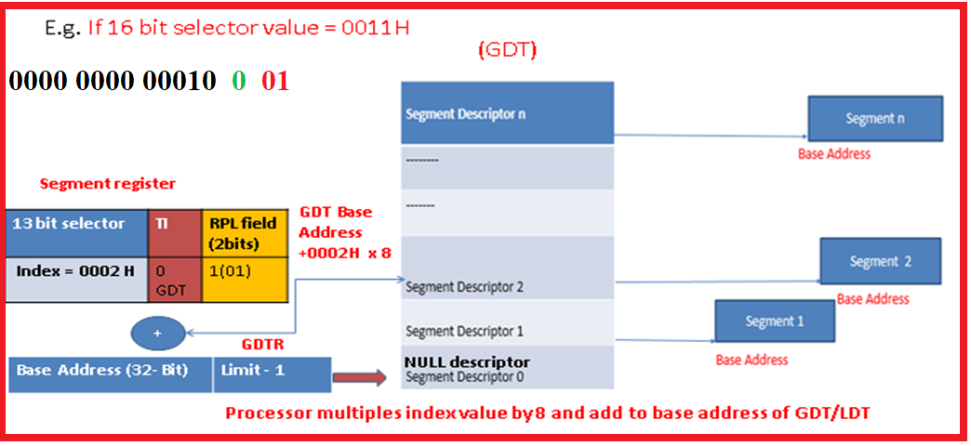
Global Descriptor Table and Segment Selector
In protected mode to access byte from any segment Linear Address is calculated by adding Base address from respective segment descriptor and offset address.

Slide 63
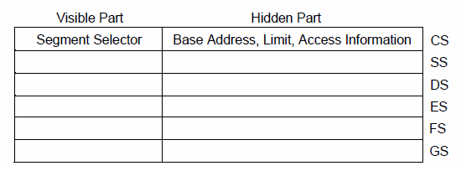
Segment Registers
Six Segment Registers available
Instructions used to load registers are either direct load (MOV, LDS) or
implied load instruction (CALL, JMP).

Slide 64
Segment Registers
To reduce address translation time and coding complexity, processor provides 6 registers for holding segment selectors.
Each one supports specific type of memory reference
CS: Code Segment
DS: Data Segment
SS: Stack Segment
Virtually to execute any program at least 1 CS, 1 DS and 1 SS must be loaded with valid addresses.
Processor provided additional 3 data segment registers as : ES, FS and GS

Slide 65
Null Segment Selector
First entry of GDT is not used by Processor. A segment selector which points to first entry of GDT is called as Null Segment Selector.
Segment selector to this “null descriptor” does not generate an exception when loaded into a data-segment register (DS, ES,FS, or GS).
An attempt to load a null segment selector into the CS or SS segment register generates a general-protection exception (#GP).
But it always generates a general-protection exception (#GP) when an attempt is made to access memory using the descriptor.
By initializing the segment registers with this segment selector, accidental reference to unused segment registers can be guaranteed to generate an exception.

Slide 66
Segment Selector
When loading segment selector following checks are made:
The selector index is within the descriptor table limit.
The selector references the correct descriptor table.
The descriptor is of correct type.
The selector uses the correct privilege level.

Slide 67
Physical Address Space
In protected mode, the Intel Architecture provides a normal physical address space of 4 GBytes (2³² bytes).
This is the address space that the processor can address on its address bus.
Physical Address space is Flat (Un-segmented) ranging from 0 to FFFFFFFFH (32 bits)
This physical address space can be mapped to read-write memory, read-only memory, and memory mapped I/O
The physical memory can be divided into segments and/or pages by memory mapping facilities available in protected mode.

Slide 68
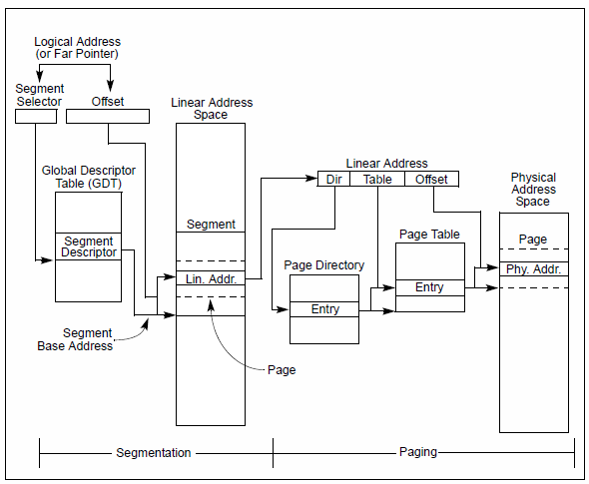
Segmentation and Paging

Slide 69
Problem (Only to clear the concept and learn to apply the concept)
Q. If DS = 0032H then which segment descriptor will be selected?.
From GDT or LDT? What will be the starting address (Offset) of selected segment descriptor in GDT.
If GDTR value is 0000 4000 FFFFH then calculate the linear address of Segment descriptor.
If selected descriptor has value as 000F 9000 5000 FFFFH and
ESI has the value as 00008259H
then calculate the linear address in data segment pointed by ESI.

Slide 70
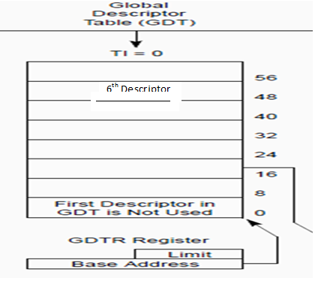
Solution (Only to clear the concept and learn to apply the concept)
Linear address = Base address of segment + Offset
Offset is given as 0000 8259H
We have to calculate Base address:
Step 1: DS = 0032H = 0000 0000 0011 0010 b
RPL = 10 = PL2
TI = 0 => GDT will be selected
Index = 0000 0000 0011 0
= 0 0000 0000 0110 = 0006H
So 6th descriptor from GDT will be selected.
Step 2: Offset of Descriptor = 6 * 8 = 48 or 30H

Slide 71
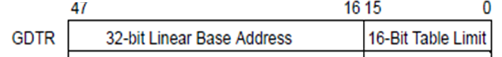
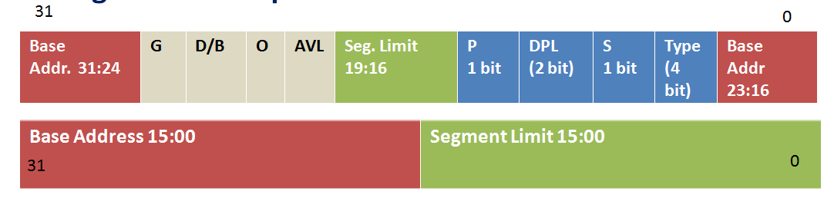
Solution (Only to clear the concept and learn to apply the concept)
Linear address = Base address of segment + Offset
Offset is given as 0000 8259H
We have to calculate Base address:
Step 3: Linear address of Descriptor = Offset + Base address of GDT
= 30H + 0000 4000 H = 0000 4030H
Given value of GDTR = 0000 4000 FFFFH ; 0000 4000H is base address of GDT and FFFFH is Limit value
Step 4: Given value of segment Descriptor is 000F 9000 5000 FFFFH
Base address is 0000 5000H ; and Limit is FFFFFH
Step 5 : Linear address within segment = 0000 5000H + 0000 8259H = 0000 D259H

Slide 72
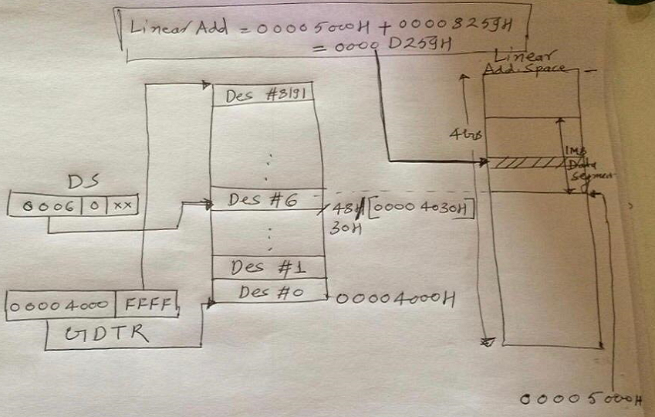

Slide 73
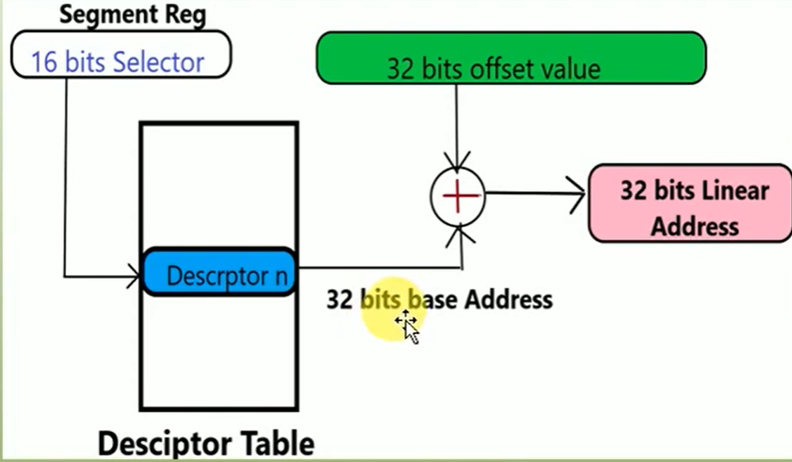
Logical and Linear Addresses Generation

Slide 74
Logical and Linear Addresses Generation
At the system-architecture level in protected mode, the processor uses two stages of address translation to arrive at a physical address:
Logical-address translation (Segmentation) and linear address space (Paging).
Every byte in the processor’s address space is accessed with a logical address.

Slide 75
Logical and Linear Addresses Generation
A logical address consists of a 16 bit segment selector and 32-bit offset.
Segment selector identifies the segment the byte is located in.
The offset specifies the location of the byte in the segment relative to the base address of the segment.
The processor translates every logical address into a linear address.
A linear address is a 32 bit address in the processor’s linear address space from 0 to FFFFFFFFH.
It contains all the segments and system tables defined for a system.

Slide 76
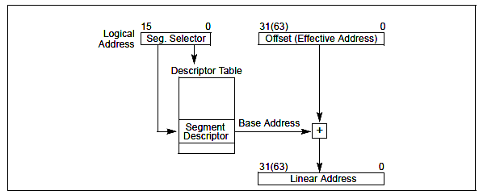
Logical and Linear Address Translation
To translate a logical address into a linear address, the processor does the following:
1. Uses the offset in the segment selector to locate the segment descriptor for the segment in the GDT or LDT and reads it into the processor. (step is needed only when a new segment selector is loaded into a segment register.)
2. Examines the segment descriptor to check the access rights and range of the segment to insure that the segment is accessible and that the offset is within the limits of the segment.
3. Adds the base address of the segment from the segment descriptor to the offset to form a linear address.
https://www.geeksforgeeks.org/logical-and-physical-address-in-operating-system/

Slide 77
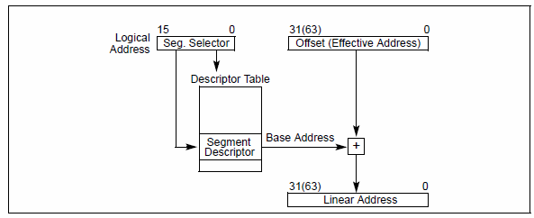
Logical and Linear Addresses Generation
If paging is not used, the processor maps the linear address directly to a physical address (that is, the linear address goes out on the processor’s address bus).
If the linear address space is paged, a second level of address translation is used to translate the linear address into a physical address.

Slide 78
Accessing Segment
Linear Address= Base address (Segment descriptor) + Offset Addr (Pointer register)
Linear Address of segment descriptor
(present in GDT/LDT)= (32 bit Base Address of GDT)
+ 13 bit Index x 8 (Offset with in GDT)
*Reference: Part of the slide is taken from PPTs created by Prof. S. D. Oza
Segment base address (32 bit)
GDT
Offset
(32)
Offset
(32)
Offset
(32)
Offset
(32)
Offset
(32)
Offset
(32)
Offset
(32)
Segment Descriptor n
Segment Descriptor 2
Segment Descriptor 1
NULL Descriptor
Offset address Address
Offset address Address
Offset address Address
Offset address Address
Offset address Address
+
+
Segment register 16 bit
+
13 bit index X 8 | TI | RPL
Linear address (32 bit)
offset Limit
.
.
2
Offset 1
Offset 0
Linear address (32 bit)
+
GDTR
offset
32 bit Base Address
Base Address (32 Bit) | Limit – 1 (16 Bit
Segment
78

Slide 79



Slide 80


Slide 81
Q1 | Explain segment level protections in Pentium.
Q2. | If the value in the segment selector is DS=0043H, find Descriptor table accessed Descriptor number in the table Address of the descriptor (Assume GDT Base Address is 00000010H) d. RPL value
Q3. | For a given instruction MOV BL, [ESI], assume that ESI=00220011 H, the base address of the LDT is 00123400H and the GDT base address is 00100110H. If the value of the selector loaded into the DS register is 003DH, then what is the request privilege level? Is the segment descriptor located in the GDT or LDT? What is the address of the segment descriptor? Calculate Physical address (Linear Address as Paging is disabled). Assume base address of the segment present in its segment descriptor is 11000011H and LDTR is 0111H.

Slide 82

Solution
For a given instruction MOV [ESI],BH. Assume that ESI=11000011 H, the base address of the LDT is 11120000H and the GDT base address is 00123000H. If the value of the selector loaded into the DS register is 0046H, then what is the request privilege level? Is the segment descriptor located in the GDT or LDT? What is the address of the segment descriptor? Calculate Physical address (Linear Address as Paging is disabled). Assume base address of the segment present in its segment descriptor is 10010011H and LDTR is 0110H.

Slide 83

Linear Addr = Base address of the segment + Offset
= 10010011 + 11000011 = 21010022 H
Linear address itself is Physical address.

Slide 84


Logical to Linear Address Translation

Slide 85
Logical to Linear Address Translation
To locate any Byte in the Segment the logical address must be provided.
Logical address consist of Segment Selector and Offset called as Pointer.
Segment Selector is a unique Identifier which provides Offset in Descriptor Table (GDT/LDT) to a data structure called as Segment Descriptor.
Offset of descriptor in GDT/LDT = 13 bit Index value of selector x 8 = m^{th} descriptor x 8.
(As size of segment descriptor is of 8 byte and 13 bit Index value gives mth descriptor in the table).
Linear Address of Segment Descriptor = Offset of descriptor (mth descriptor x 8) + Base address of GDT (given by GDTR).
Each Segment Descriptor specifies Base Address of Segment.
Offset part of logical address is added to locate byte within Segment.
Linear Address of Byte to be Accessed from memory segment = Base Address of segment
+ Offset part of logical address.

Slide 86

Accessing LDT Local Descriptor Table (LDT), LDTR and Segment Selector

Slide 87







Accessing LDT Local Descriptor Table (LDT), LDTR and Segment Selector
DS=0015 H, LDTR=0018 H

Slide 88

Accessing LDT
Linear Address of LDT segment descriptor (present in GDT) =
32 bit Base Address of GDT + 13 bit Index x 8 (Offset within GDT)

Slide 89
Logical to Linear Address Translation
Accessing GDT
Accessing LDT

Slide 90

LDT and Local Descriptor Table Register (LDTR)
The segment that contains LDT must have its segment descriptor in the GDT.
LDTR acts as a selector to refer a Local Descriptor Table (LDT) descriptor in the GDT.
The visible portion of the LDT register contains only a 16-bit selector.
Holds 16 bit segment selector, base address, limit and descriptor attributes for the (when accessing the LDT, the segment selector, base linear address, limit, and access rights of the LDT are stored in the LDTR register)

Slide 91

LDTR
LLDT and SLDT instructions are used to load and store LDTR Register
During Task switch, LDTR is loaded automatically
Content of LDTR are not automatically saved prior to writing new LDT
On power ON default value is set to 0 with limit 0FFFFH

Slide 92

Accessing LDT
For a given instruction MOV [ESI],BH.
Assume that ESI=11000011 H, the base address of the LDT is 11120000H and the GDT base address is 00123000H. If the value of the selector loaded into the DS register is 0046H, then what is the request privilege level? Is the segment descriptor located in the GDT or LDT? What is the address of the segment descriptor? Calculate Physical address (Linear Address as Paging is disabled). Assume base address of the segment present in its segment descriptor is 10010011H and LDTR is 0110H.
Ans: Linear Addr = Base address of the segment + Offset
= 10010011 + 11000011 = 21010022 H
Linear address itself is Physical address.

Slide 93

Memory Management Registers
System provided 4 memory management registers GDTR, LDTR, IDTR and TR

Slide 94
Task Register (TR)
Holds 16 bit segment selector, base address, limit , descriptor attribute for the Task State Segment (TSS) of the current task
Selector refers the TSS descriptor in GDT
LTR and STR instructions are used to store and load values in TR register
On power ON default value is set to 0 with limit 0FFFFH
On task switch TR is loaded automatically, it can’t save its prior content automatically

Slide 95
Segment Descriptor
Is a data structure in GDT/ LDT that provides the size and location of the segment as well control & status information.
Segment descriptors are created by compiler, linker, loader or operating system but not application programs.
Base Addr. 31:24 | G | D/B | O | AVL | Seg. Limit 19:16 | P | DPL (2 bit) | S | Type (4 bit) | Base Addr 23:16
Base Address 15:00 | Segment Limit 15:00

Slide 96
Segment Descriptor
Every memory segment is described by a called segment descriptor special structure.
It describes-
Segment Base Address ( Location of first byte of the segment in the linear address space)
Size/Length/Limit of Segment (largest valid offset of the segment described)
Segment type/Use
Privilege Level
Access Right/Miscellaneous
Size – 8byte
Created in GDT or LDT
Created by: OS

Slide 97

Segment Descriptor Format
Base Addr. 31:24 | G | D/B | O | AVL | Seg. Limit 19:16 | P | DPL (2 bit) | S | Type (4 bit) | Base Addr 23:16
Base Address 15:00 | Segment Limit 15:00
Base Address - Segment Base Address
LIMIT Segment Limit
Access Rights Byte –
P: Segment Present
S: Descriptor type (System Descriptor (0) or Non Segment Descriptor (1))
TYPE Segment Type
DPL Descriptor’s Privilege Level
AVL – Segment is available for user or NOT
D/B Default operation size
G Granularity

Slide 98

Segment Descriptor
Segment descriptor fields

Slide 99

QUIZ on : Segment Descriptor and Format
Base | G | D/B | O | AVL | Seg. Limit | P | DPL | S | Type | Base Addr
Base Address | Segment Limit

Slide 100

Types of Segment Descriptor and Format
Base Addr. 31:24 | G | D/B | O | AVL | Seg. Limit 19:16 | P | DPL (2 bit) | S | Type (4 bit) | Base Addr 23:16
Base Address 15:00 | Segment Limit 15:00
Access Rights Byte –
P: Segment Present
S: Descriptor type (System Descriptor (0)
or Non Segment Descriptor (1))
TYPE: Segment Type
DPL: Descriptor’s Privilege Level
1

Slide 101

Segment Descriptor Format

Slide 102
Segment Descriptor Format
Base Address field: defines location of the byte 0 of the segment within 4 GBytes linear address space. The processor puts together 3 base address fields to form 32 bit value.
Segment limit field: specifies the size of segment.
Processor puts together two segment limit fields to form 20 bit value
Specified by the last offset of the segment or size -1

Slide 103
Segment Descriptor Format
Segment limit field: specifies the size of segment
If Granularity bit is 0, segment size can range from 1 Byte to 1 MByte,
in byte increment
0000 0000 0000 0000 0000 0000 0000 0000 – 0 Byte
0000 0000 0000 1111 1111 1111 1111 1111- 1MByte
If Granularity bit is 1, segment size can range from (Used in paging) 4KBytes to 4 GBytes , in 4KBytes (2^12=4096=1000H) increment
0000 0000 0000 0000 0000 1111 1111 1111– 4KBytes
1111 1111 1111 1111 1111 1111 1111 1111 - 4 GBytes
Base Addr. 31:24 | G 23 | D/B | O | AVL | Seg. Limit 19:16 | P | DPL (2 bit) | S | Type (4 bit) | Base Addr 23:16

Slide 104
Calculation: Size of segment
In a segment descriptor if limit field is 00F00H then find the size of the segment, if
G bit = 0
b. G bit = 1
Memory size:
If G=0: 1MB:
Segment can be 1 byte to 1Mbyte
So limit of segment is
0000H to FFFFFH
Segment size =Segment field*1byte = 00F00H*1=0F00H
Memory size:
If G=1: 1GB:
Segment can be 4Kbyte to 4Gbyte
So limit of segment is
00000000H to FFFFFFFFH
Segment size= Segment field*4Kbyte= 00F00H*1000H=F00000H

Slide 105
Quiz: Calculation: Size of segment
In a segment descriptor if limit field is 000FFH then find the size of the segment, if
G bit = 0
b. G bit = 1
Memory size:
If G=1: 1GB:
Segment can be 4Kbyte to 4Gbyte
So limit of segment is
00000000H to FFFFFFFFH
Segment size= Segment field*4Kbyte= 000FFH*1000H=FF000H
Memory size:
If G=0: 1MB:
Segment can be 1 byte to 1Mbyte
So limit of segment is
0000H to FFFFFH
Segment size =Segment field*1byte = 00FFH*1=00FFH

Slide 106
Quiz
For the instruction MOV [ESI], BX
if physical address calculated is 00001111H
If the base address in the descriptor used is 00000000H
and limit field is 00010H with G bit equal to 0
then will the instruction be executed? (Comment about segmentation fault)
For the instruction MOV [ESI], BX, if physical address calculated is 000000FFH. If the base address in the descriptor used is 00000000H and limit field is 00FFFH with G bit equal to 0 then will the instruction be executed? (Comment about segmentation fault)
In the execution of the instruction MOV [EDI], CX, comment whether access will be granted or denied in following cases Type field of the segment descriptor identified is 1111 Type field of the segment descriptor identified is 0010

Slide 107

Segment Descriptor Format (Limit Field)
Segment limit field: The processor uses the segment limit depending on (segment is an expand-up or expand-down)
expand-up (Code- and Data-Segment Descriptor Types)
Addressable range stretches from base address to base address plus limit
Any address greater than limit is not valid and not considered
Expand-down segment
The offset can range from the segment limit to FFFFFFFFH or FFFFH, depending on the setting of the B (Big) flag
(D/B bit in the descriptor).
Offsets less than the segment limit are not valid and not considered

Slide 108
Segment Descriptor Format (Limit Field)
Expand-down segment
The offset can range from the segment limit to FFFFFFFFH or FFFFH, depending on the setting of the B flag (D/B bit in the descriptor).
Offsets less than the segment limit are not valid and not considered
If B bit = 1 then upper bound = FFFFFFFF(4GB)
(all PUSH & POP are 32 bits)
If B bit = 0 then upper bound = FFFF (64KB)
(all PUSH & POP are 16 bits)

Slide 109
Segment Descriptor Format (Limit Field)
Segment limit field: The processor uses the segment limit depending on (segment is an expand-up or expand-down)
Expand-Down Segment (Stack Segment Descriptor Types)
The offset can range from the segment limit to FFFFFFFFH or FFFFH, depending on the setting of the B flag.
Offsets less than the segment limit are not valid and not considered
If B bit = 1 then upper bound = FFFFFFFF(4GB) (all PUSH & POP are 32 bits)
If B bit = 0 then upper bound = FFFF (64KB) (all PUSH & POP are 16 bits)

Slide 110
Segment Descriptor Format
Granularity flag :
It determines the scaling of the segment limit field. When the granularity flag is clear (0), the segment limit is interpreted in byte units; when flag is set (1), the segment limit is interpreted in 4-KByte units.
Available and reserved bit:
Bit 20 of the second double word of the segment descriptor is available for use by system software. Bit 21 is reserved and is always zero.
Base Addr. 31:24 | G | D/B | O | AVL | Seg. Limit 19:16 | P | DPL (2 bit) | S | Type (4 bit) | Base Addr 23:16

Slide 111

Segment Descriptor Format

Slide 112
Segment Descriptor Format
Base Addr. 31:24 | G | D/B | O | AVL | Seg. Limit 19:16 | P | DPL (2 bit) | S | Type (4 bit) | Base Addr 23:16
Type Field: 4 bit field specifies the segment type, kind of access that can be made and direction of growth
S flag (Descriptor type): S=0 for is for a system segment and
S=1 for code / data segment
DPL (Descriptor Privilege Field): Specifies the privilege level of segment. It can range from 0 to 3, with 0 at highest privilege and 3 as lowest privileged
P (Segment Present) Flag: indicates whether segment is present in the memory (1) or not (0)

Slide 113
Segment Descriptor Format
D/B (default operational size) flag: performs different functions depending on the segment type. This flag should be
set to 1 for 32 bit code/data segment and
set to 0 for 16 bit code/data segment.
Executable code segment: flag is called as D flag and indicates default length for effective addresses and operands referenced by instructions in the segment
If set then 32 bit address and 32 or 8 bit operands are assumed
If clear then 16 bit address and 16 or 8 bit operands are assumed

Slide 114
Segment Descriptor Format
D/B ( default operational size) flag: performs different functions depending on the segment type. This flag should be set to 1 for 32 bit code/data segment and set to 0 for 16 bit code/data segment.
Stack segment : flag is called as B (big) flag it specifies the size of the stack pointer used for implicit stack operation.
If set 32 bit stack pointer is used
If clear 16 bit stack pointer is used
Expand down data segment: The flag is called the B flag and it specifies the upper bound of the segment.
If flag is set the upper bound is FFFFFFFF H (4 Gbytes) and
If clear upper bound is FFFF H (64KBytes)

Slide 115


Segment Descriptor Format (S Bit and Type Field)
A (Accessed bit-8) :indicates whether the segment has been accessed since the last time the operating-system cleared the bit.
The processor sets this bit whenever it loads a segment selector for the segment into a segment register. Processor never clear this bit automatically.
Base Addr. 31:24 | G | D/B | O | AVL | Seg. Limit 19:16 | P | DPL (2 bit) | S | Type (4 bit) 0 E W A | Base Addr 23:16

Slide 116

Segment Descriptor Format
When the S (descriptor type) flag=1 in a segment descriptor is set, the descriptor is for either a code or a data segment.
The highest order bit of the type field (bit 11) of the second double word determines whether the descriptor is for a data segment (clear) or a code segment (set).
Type field A (bit 8) is interpreted as Accessed flag.
For Code and Data segments, Type field bits 9 and 10 are interpreted differently.

Slide 117

Segment Descriptor Format (Data Segment)
Bit 8: A (Accessed bit) :The processor sets this bit whenever it loads a segment selector for the segment into a segment register. Processor never clear this bit automatically.
Bit 9: W (Write enable) : If set, the segment is write enabled.
Bit 10: E (Expansion Direction): If set, segment expands down.
Bit 11: Code/Data: If zero indicates data segment.

Slide 118
Descriptor - Type field (Data)
Type No. | 11 | 10 E | 9 W | 8 A | Descriptor Type | Description
0 | 0 | 0 | 0 | 0 | Data | Read only
1 | 0 | 0 | 0 | 1 | Data | Read Only, Accessed
2 | 0 | 0 | 1 | 0 | Data | Read/Write
3 | 0 | 0 | 1 | 1 | Data | Read/Write, Accessed
4 | 0 | 1 | 0 | 0 | Data | Read-Only, expand Down
5 | 0 | 1 | 0 | 1 | Data | Read-Only, expand Down, Accessed
6 | 0 | 1 | 1 | 0 | Data | Read/Write, expand down
7 | 0 | 1 | 1 | 1 | Data | Read/Write, expand down, Accessed

Slide 119

Segment Descriptor Format (Data Segment)
Stack segments are data segments which must be read/write segments.
Loading the SS register with a segment selector for a non writable data segment generates a general-protection exception (#GP).

Slide 120

Segment Descriptor Format (Code Segment)
Bit 8: A (Accessed bit) :The processor sets this bit whenever it loads a segment selector for the segment into a segment register.
Processor never clear this bit automatically
Bit 9: R (Read enable) : If set, the segment is Read enabled
Bit 10: C (Conforming): If set, segment is Conforming Code segment
Bit 11: Code/Data: If one indicates Code segment

Slide 121
Descriptor - Type field (Code)
Type No. | 11 | 10 C | 9 E | 8 A | Descriptor Type | Description
8 | 1 | 0 | 0 | 0 | Code | Execute only
9 | 1 | 0 | 0 | 1 | Code | Execute Only, Accessed
10 | 1 | 0 | 1 | 0 | Code | Execute/Read
11 | 1 | 0 | 1 | 1 | Code | Execute/Read, Accessed
12 | 1 | 1 | 0 | 0 | Code | Execute-Only, Conforming
13 | 1 | 1 | 0 | 1 | Code | Execute-Only, Conforming, Accessed
14 | 1 | 1 | 1 | 0 | Code | Execute/Read - only, Conforming
15 | 1 | 1 | 1 | 1 | Code | Execute/Read - only, Conforming, Accessed

Slide 122
System Descriptor Types
When S =0, the descriptor type is a system descriptor.
The processor recognizes the following types of system descriptors:
System Segment Descriptors
Local descriptor-table (LDT) segment descriptor
Task-state segment (TSS) descriptor.
Gate descriptors:
Call-gate descriptor
Interrupt-gate descriptor
Trap-gate descriptor
Task-gate descriptor
Gate descriptors: are “gates,” which hold pointers to procedure entry points in code segments (call, interrupt, and trap gates)
or which hold segment selectors for TSS’s (task gates).

Slide 123
System Descriptor Type
System Segment Descriptor
Base Addr. 31:24 | G |  | 0 |  | Seg. Limit 19:16 | P | DPL | S ‘0’ | TYPE | Base Addr 23:16 | Base Addr 15:00 | Segment Limit 15:00
LDT Segment Descriptor
Base Addr. 31:24 | 0 | 0 | 0 | 0 | Seg. Limit 19:16 | P | DPL | S ‘0’ | TYPE 0010 | Base Addr 23:16 | Base Addr 15:00 | Segment Limit 15:00

Slide 124



System Descriptor Types

Slide 125
Field and Flag in Protection system
Data Segment Descriptor
Base Addr. 31:24 | G | B | 0 | AVL | Seg. Limit 19:16 | P | DPL | S ‘1’ | 0 | E | W | A | Base Addr 23:16 | Base Addr 15:00 | Segment Limit 15:00
TYPE
Code Segment Descriptor
Base Addr. 31:24 | G | D | 0 | AVL | Seg. Limit 19:16 | P | DPL | S ‘1’ | 1 | C | R | A | Base Addr 23:16 | Base Addr 15:00 | Segment Limit 15:00
TYPE
System Segment Descriptor
Base Addr. 31:24 | G |  | 0 |  | Seg. Limit 19:16 | P | DPL | S ‘0’ | TYPE | Base Addr 23:16 | Base Addr 15:00 | Segment Limit 15:00

Slide 126



Field and Flag in Protection system

